Slide 1
A Case Study Analysis of Cyclistic Bike Rider Habits
Usborn Ocampo

Slide 2
Business Task
Analyze the difference between casual rider and annual member rider habits
Convert casual riders into annual members

Slide 3
About the Data
The data was obtained from by Motivate International Inc.
Data shows each ride from the last 12 months, including start and end times/locations, bike information, and rider information
Data is current as it contains ride information from the past 12 months

Slide 4
Data Processing Notes
The data to be well-formatted with no errors
Some data points missing (start and end station data), but this data point is not used for my analysis.

Slide 5
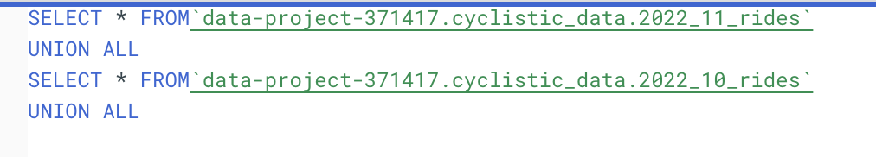
Combining Files in Bigquery

Slide 6
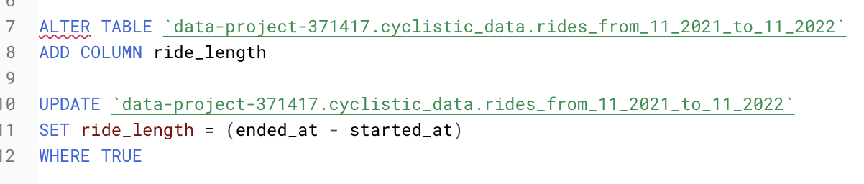
Adding “ride_length” and “day_of_week” columns

Slide 7
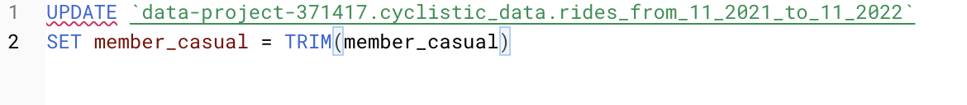
Cleaning data

Slide 8
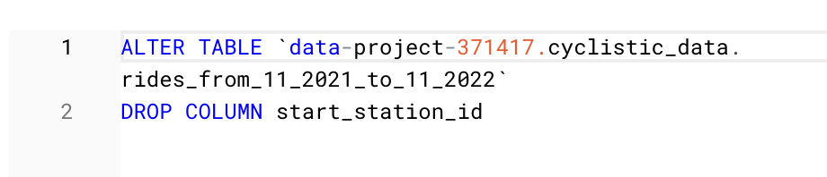
Dropping Irrelevant Columns

Slide 9
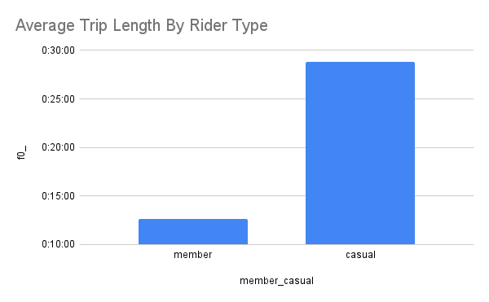
Generated in Google Sheets

Slide 10
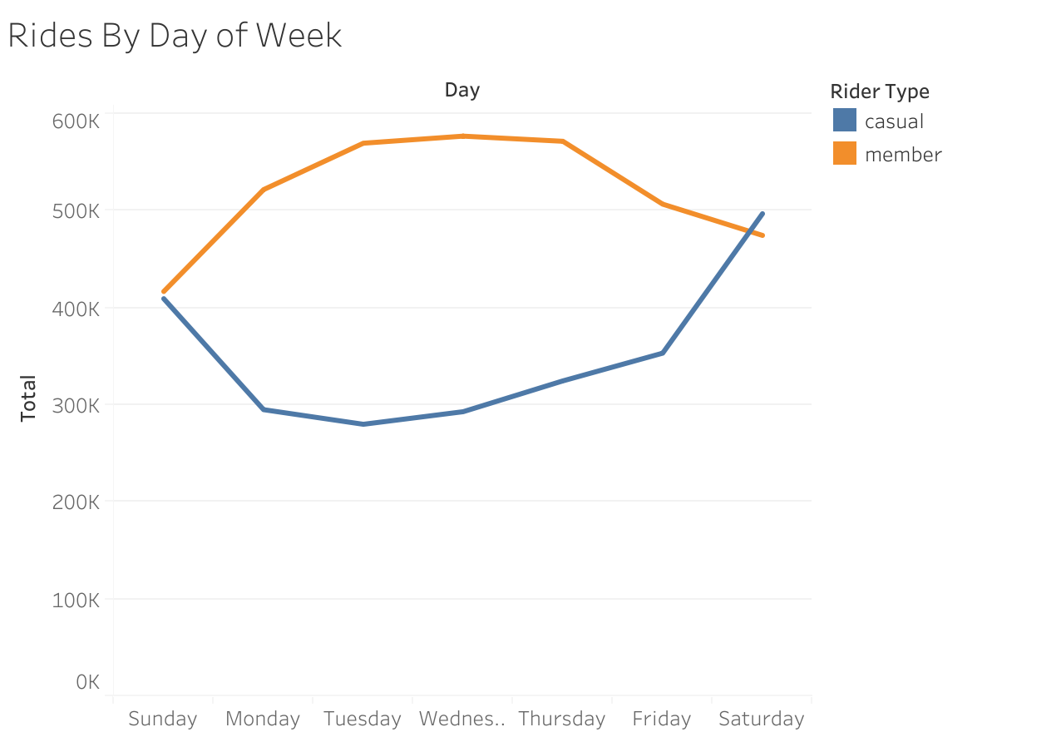
Generated in Tableau

Slide 11
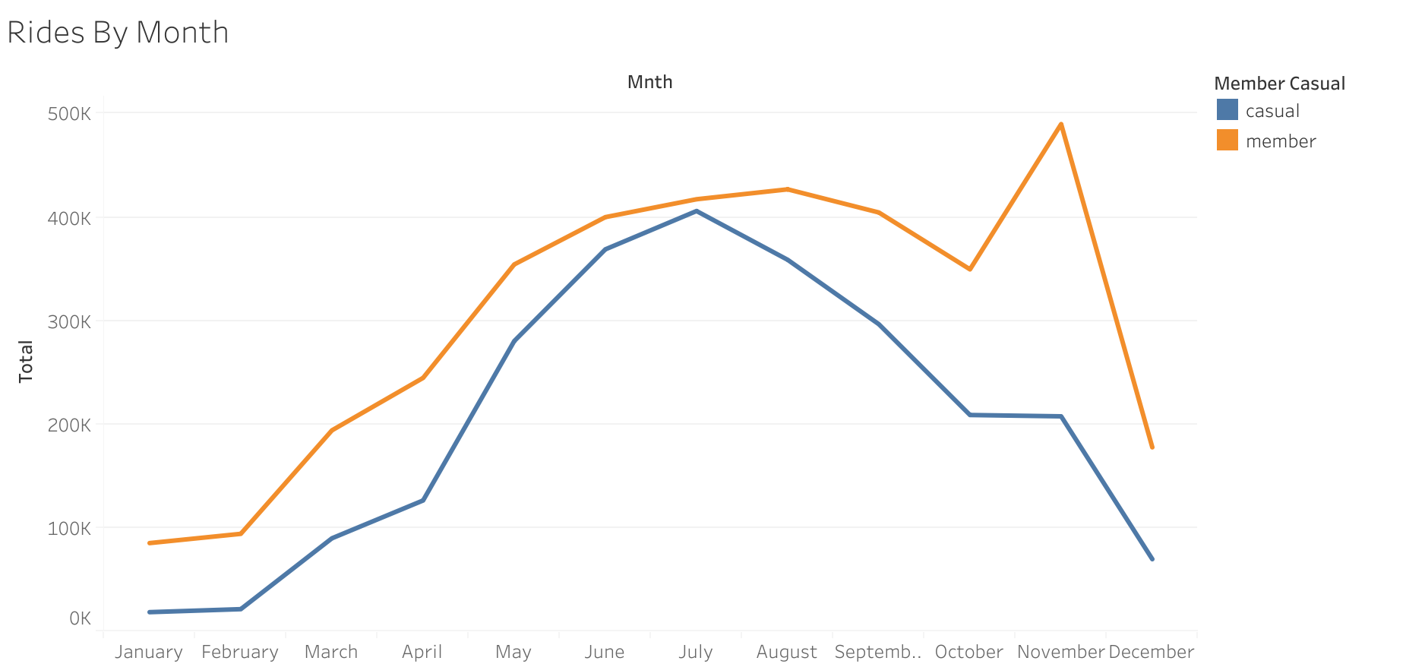
Generated in Tableau

Slide 12
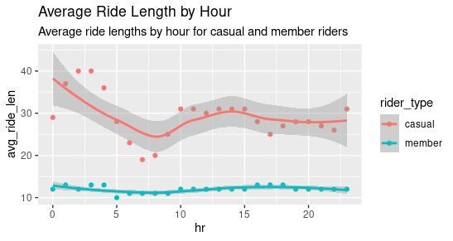
Generated in RStudio

Slide 13
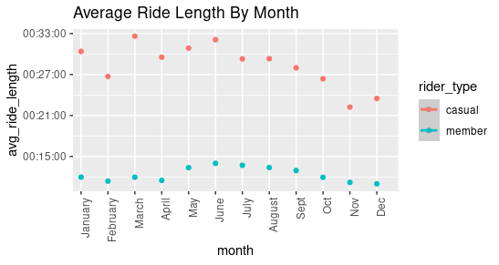
Generated in RStudio

Slide 14
Recommendations
Consider additional pricing tiers for an annual plan that provides value for riders who ride recreationally.
Focus marketing efforts on spring and summer months to reach the most casual riders.
Consider qualitative data collection to find out why casual riders don’t opt for a membership.

Slide 15
Sources
Data:
Divvy Trip Data
Tools:
Google Sheets
Bigquery
Tableau Public
RStudio

